Slide 1
Memory Management Unit for Embedded RRAM – UPDATE [1.2]
by
Shikhar Tuli
Under the guidance of Dr. Alexandre Levisse
Embedded Systems Laboratory, EPFL

Slide 2
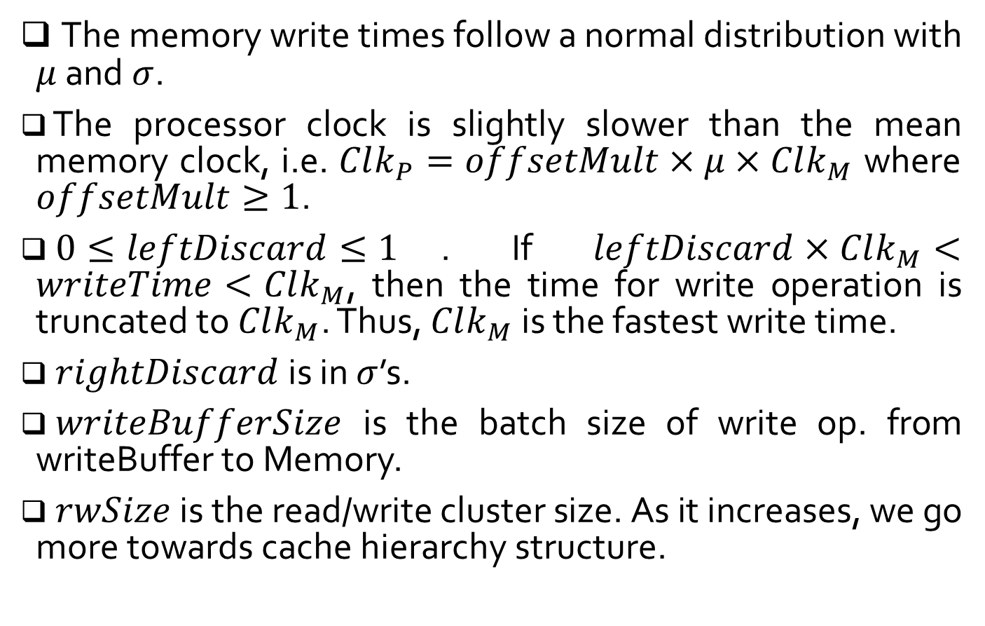
Definitions
The memory write times follow a normal distribution with $μ$ and $σ$.
The processor clock is slightly slower than the mean memory clock, i.e. $Clk_{P}=offsetMult×μ×Clk_{M}$ where $offsetMult≥1$.
$0≤leftDiscard≤1$. If $leftDiscard×Clk_{M}<writeTime<Clk_{M}$, then the time for write operation is truncated to $Clk_{M}$. Thus, $Clk_{M}$ is the fastest write time.
$rightDiscard$ is in $σ$’s.
$writeBufferSize$ is the batch size of write op. from writeBuffer to Memory.
$rwSize$ is the read/write cluster size. As it increases, we go more towards cache hierarchy structure.
#2

Slide 3
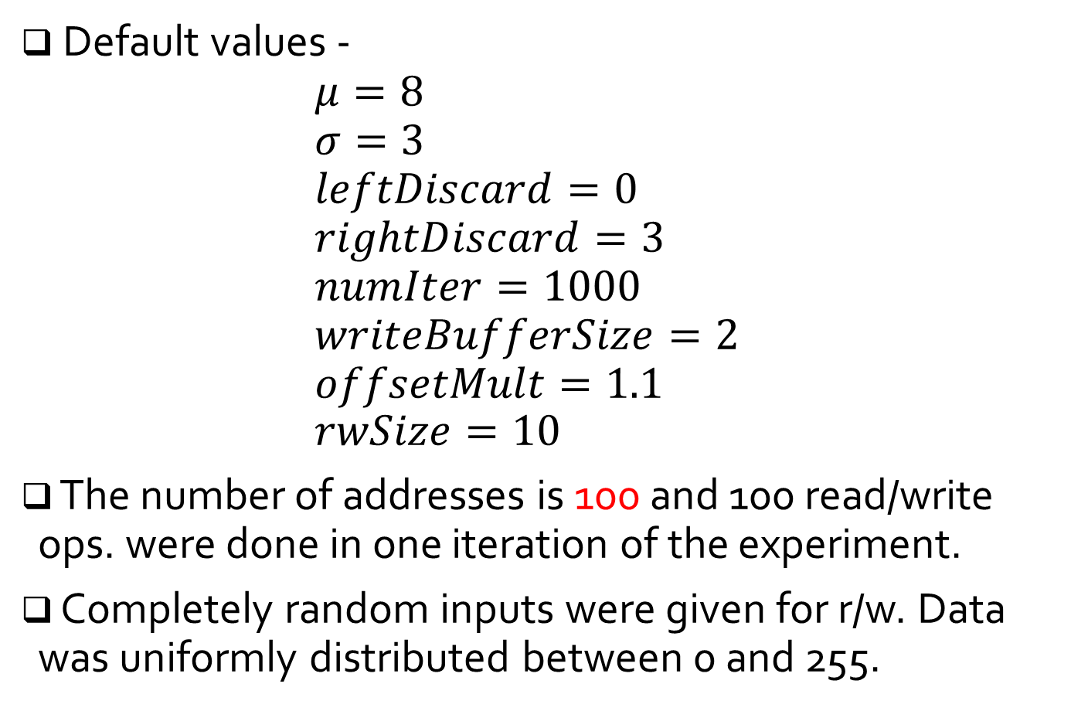
Definitions (contd.)
Default values - $μ=8$ $σ=3$ $leftDiscard=0$ $rightDiscard=3$ $numIter=1000$ $writeBufferSize=2$ $offsetMult=1.1$ $rwSize=10$
The number of addresses is 100 and 100 read/write ops. were done in one iteration of the experiment.
Completely random inputs were given for r/w. Data was uniformly distributed between 0 and 255.
#3

Slide 4

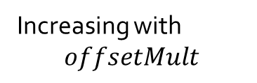

Observations
$offsetMult$ varied from $1$ to $2$. Only write ops. (i.e. $rwSize=100$). Parallel write considered.
No variability due to deterministic r/w ops in reference. All parallel operations take $writeBufferSize×\left(μ + rightDiscard×σ\right)× Clk_M$
Increasing with
$$offsetMult$$
✓
#4

Slide 5

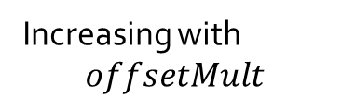
Observations (contd.)
$offsetMult$ varied from $1$ to $2$. Only write ops. (i.e. $rwSize=100$). Serial write considered.
Increasing with
$$offsetMult$$
✓
??
#5

Slide 6

Observations (contd.)
$writeBufferSize$ varied from $1$ to $100$. Only write ops. (i.e. $rwSize=100$). Parallel write considered.
With increasing batch size, the write times are increasing.
Saturation
✓
Trade-off critical batch sizes
#6

Slide 7

Observations (contd.)
$writeBufferSize$ varied from $1$ to$100$. Only write ops. (i.e. $rwSize=100$). Serial write considered.
Saturation
With increasing batch size, the write times are increasing.
✓
#7

Slide 8

Observations (contd.)
$rwSize$ varied from $2$ to $10$. Parallel write considered. Batch size is 5
Systematic
drop ??
Write times increase beyond roughly half the number of addresses.
✓
#8

Slide 9

Observations (contd.)
$rwSize$ varied from $2$ to $10$. Serial write considered. Batch size is 5
Systematic
drop ??
Again, write times increase beyond half the number of addresses.
✓
#9

Slide 10
Observations (contd.)
Corner case write operation. Comparison between proposed and reference for both 0-255-0 and 0-0 operations (Parallel). Batch size is 1.
Variability
No variability
#10

Slide 11
Observations (contd.)
Corner case write operation. Comparison between proposed and reference for both 0-255-0 and 0-0 operations (Serial). Batch size is 1.
No variability
Variability
#11

Slide 12
Thank you
#12

